Slide 1
Behavior Support for Adolescents
PTT
Notes:
Have them brainstorm a skill that they have been working on that is tough

Slide 2
Agenda
Follow-Up and Questions (10 min)
Behavior Support Presentation (35 min)
Practice Activity (20 min)
Questions/Discussion (10 min)
Parent Socialization (15 min)

Slide 3
Importance of Continuing to Use Behavioral Supports in Adolescence

Slide 4
Teaching/practicing skills
We want to build social abilities that we know will serve your children in the long run
Techniques rooted in theories of learning and behavior (e.g., applied behavior analysis) can be successfully applied to all kinds of skills across the lifespan
Academic
Behavioral
Adaptive living
Social skills
Direct instruction, modeling, practice, and feedback are highly effective in teaching/practicing skills for people of all ages
Notes:
E

Slide 5
Teaching/practicing skills
It is important to consider the level at which a skill should be performed and the value of the skill to your individual child
Measurement of whether skills have been learned can be examined through a variety of methods:
Percentage of opportunities successful
Accuracy over time
Latency (how long until individual starts on a skill)
Duration (how long the individual does the skill)

Slide 6
Addressing behavior challenges
Changing the environment by attending to and changing what happens before (antecedent) and/or after (consequence) a behavior can help to address difficult behaviors with your child/pre-teen/teenager

Slide 7
Changes in Adolescence
Influence Behavior

Slide 8
Factors that can contribute to challenging and risk-taking behaviors
Peers
Time unsupervised by adults
Still incomplete frontal lobe development
Notes:
Frontal Lobe: Problem solving/decision-making/impulse control

Slide 9
Teaching Skills Through Behavioral Approaches

Slide 10
Behavioral Skills Training (BST)
Four-step procedure designed for teaching children with ASD a target skill
Instruction
Review all steps of the skill (visually and/or verbally)
Modeling
Live demonstration or video modeling the skill
Rehearsal
Child practices all steps of the skill
Feedback
Provide reinforcement/praise when the skill is performed correctly
Correct any errors made when the skill is performed incorrectly
(Miltenberger, 2012)

Slide 11
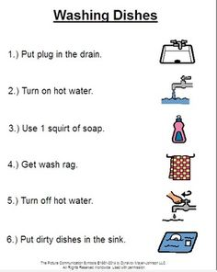
Conducting a task analysis
A task analysis involves breaking a skill down into manageable, smaller components.
Example: Brushing Teeth

Slide 12
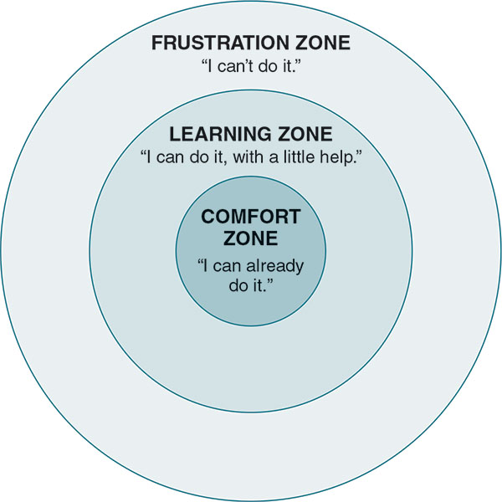
Scaffolding
When children learn a new skill, we need to provide guidance and support, then lessen that support little by little until they can do the skill independently.

Slide 13
Increasing Positive/
Reducing Interfering Behaviors

Slide 14
Antecedents
Various things that you say or do that make a behavior more or less likely to occur
Prompts
Verbal
Physical

Slide 15
Antecedents - Setting Events
Often how something is said or presented
Positive setting events
Calm tone of voice and facial expression
Can add choice of two acceptable options
Offering assistance
Negative setting events
Harsh tone
Sarcasm
“Because I said so”

Slide 16
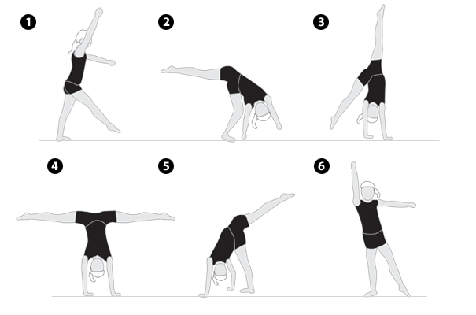
Shaping Behaviors
Shaping: a target skill is gradually taught by reinforcing successive approximations of the skill until the child can perform the target skill.
Notes:
Allura

Slide 17
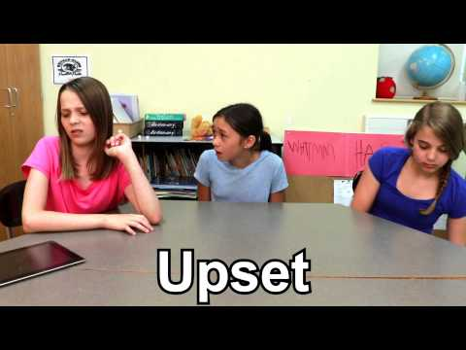
Modeling Behaviors

Slide 18
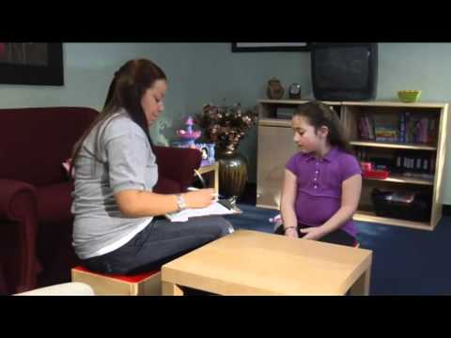
Fading Supports
While prompting can help individuals learn skills, prompts must be faded out to prevent prompt-dependency

Slide 19
Consequences
Something that happens after a behavior occurs that increases or decreases the likelihood of occurrence of the same behavior under the same conditions in the future
Can be positive or negative

Slide 20
Consequences: attending to favorable behaviors
Praise
Attending to the “positive opposite” of an undesired behavior
Can even just say “I noticed that you ____” - this is still positive attention
Point programs/rewards may be effective
Notes:
More effective in behavior change to attend to favorable behaviors than to punish negative behaviors
Positive opposite example: E.g., Your child swears when frustrated and you notice that one time, your child becomes frustrated and does not swear. You then bring positive attention to the fact that the child got frustrated and expressed frustration calmly/used a coping skill
Point programs example: E.g., Earning points (that can later be cashed in for a prize) for washing dishes without reminder

Slide 21
Effective Praise
For preteens, praise is often best received when it is:
Low-key
Brief
Specific
Provided privately
Include some gesture that indicates approval (e.g., a “pound” or high five) that your child is receptive to
Find what works for your child!

Slide 22
Consequences: ignoring interfering behaviors
Planned ignoring of undesired behaviors so that they are not reinforced with attention can be effective
Reprimands and taking away objects/privileges are not usually very successful strategies

Slide 23
Resource
Alan Kazdin: Everyday Parenting
https://www.coursera.org/learn/everyday-parenting

Slide 24
Let’s practice!
Notes:
Visual to engage in task analysis
Make a phone call: Do a task analysis and then use BST to train your neighbor

